Slide 1
Data Mining for Business Intelligence
- Chapter 2 -
Kichun Lee, Ph.D.,
Department of Industrial Engineering,
Hanyang University, Seoul, Korea

Slide 2
Steps in Data Mining
Define/understand purpose
Obtain data (may involve random sampling)
Explore, clean, pre-process data
Reduce the data; if supervised DM, partition it
Specify task (classification, clustering, etc.)
Choose the techniques (regression, CART, neural networks, etc.)
Iterative implementation and “tuning”
Assess results – compare models
Deploy best model
<number>/28

Slide 3
Obtaining Data: Sampling
Data mining typically deals with huge databases
Algorithms and models are typically applied to a sample from a database, to produce statistically-valid results
However, often the event of interest is rare
Examples: response to mailing, fraud in taxes, …
Sampling may yield too few “interesting” cases to effectively train a model
A popular solution: oversample the rare cases to obtain a more balanced training set
Later, need to adjust results for the oversampling
<number>/28

Slide 4
Types of Variables
Determine the types of pre-processing needed, and algorithms used
Main distinction: Categorical vs. numeric
Numeric:
  Continuous , integer
  May occasionally need to “bin” into categories
Categorical
  Ordered (low, medium, high), unordered (male, female)
  In most other algorithms, must create binary dummies (number of dummies = number of categories – 1)
<number>/28

Slide 5
Detecting Outliers
An outlier is an observation that is “extreme”, being distant from the rest of the data (definition of “distant” is deliberately vague)
Outliers can have disproportionate influence on models (a problem if it is spurious)
An important step in data pre-processing is detecting outliers
Once detected, domain knowledge is required to determine if it is an error, or truly extreme.
In some contexts, finding outliers is the purpose of the DM exercise (airport security screening). This is called “anomaly detection”.
<number>/28

Slide 6
Handling Missing Data
Most algorithms will not process records with missing values. Default is to drop those records.
Solution 1: Omission
  If a small number of records have missing values, can omit them
  If many records are missing values on a small set of variables, can drop those variables (or use proxies)
  If many records have missing values, omission is not practical
Solution 2: Imputation
  Replace missing values with reasonable substitutes
  Lets you keep the record and use the rest of its (non-missing) information
<number>/28

Slide 7
Normalizing (Standardizing) Data
Used in some techniques when variables with the largest scales would dominate and skew results
Puts all variables on same scale
Normalizing: Subtract mean and divide by standard deviation
Alternative function: scale to 0-1 by subtracting minimum and dividing by the range
  Useful when the data contain dummies and numeric
<number>/28

Slide 8
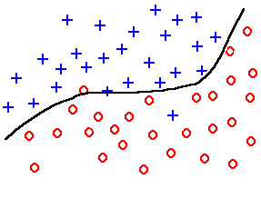
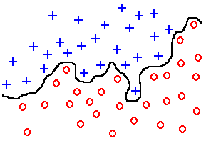
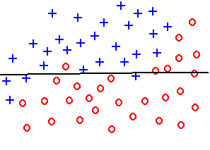
The Problem of Overfitting
Statistical models can produce highly complex explanations of relationships between variables
The “fit” may be excellent
When used with new data, models of great complexity do not do so well.
underfitting
good fit
overfitting
<number>/28

Slide 9
The Problem of
Overfitting
(Continued)
x₂
x₂
x₁
x₁
15
<number>/28
Notes:
Which one is best : linear or non-linear
The decision comes when we see new data
Very often the simplest model is better
This principle is implemented in Learning Theory

Slide 10
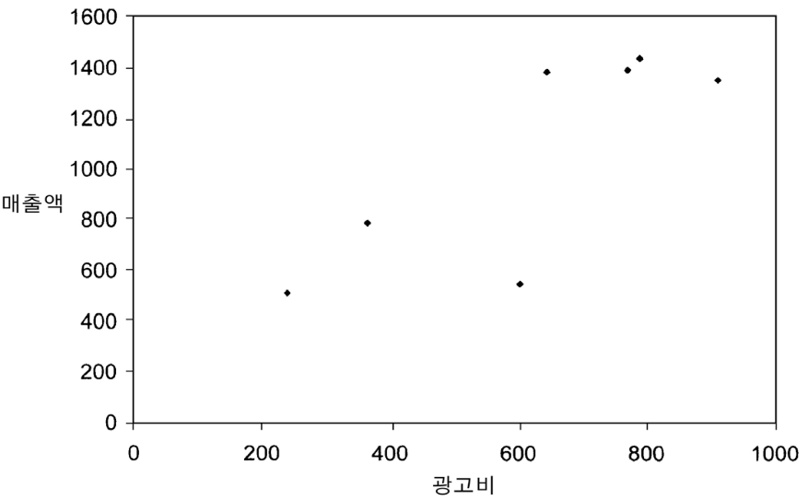
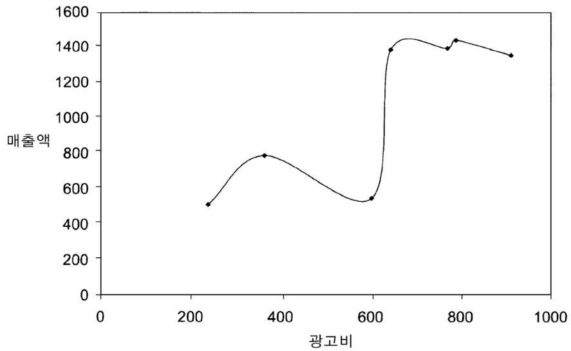
The Problem of
Overfitting
(Continued)
<number>/28

Slide 11
The Problem of
Overfitting
(Continued)
Causes:
  Too many predictors
  A model with too many parameters
  Trying many different models
Consequence: Deployed model will not work as well as expected with completely new data.
<number>/28

Slide 12
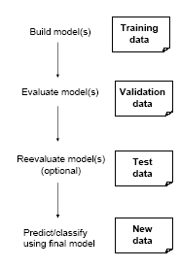
Partitioning the Data
Problem: How well will our model perform with new data?
Solution: Separate data into two parts
  Training partition to develop the model
  Validation partition to implement the model and evaluate its performance on “new” data
Addresses the issue of overfitting
<number>/28

Slide 13
Test Partition
When a model is developed on training data, it can overfit the training data (hence need to assess on validation)
Assessing multiple models on same validation data can overfit validation data
Some methods use the validation data to choose a parameter. This too can lead to overfitting the validation data
Solution: final selected model is applied to a test partition to give unbiased estimate of its performance on new data
<number>/28

Slide 14
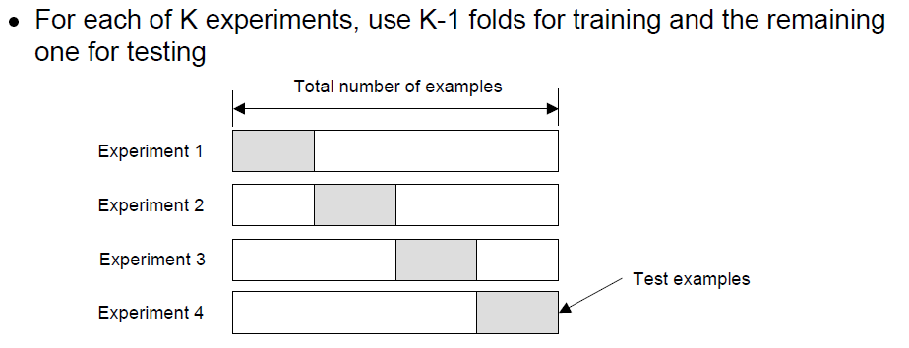
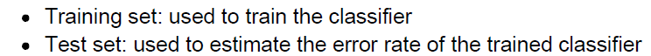
Cross-Validation
<number>/28

Slide 15
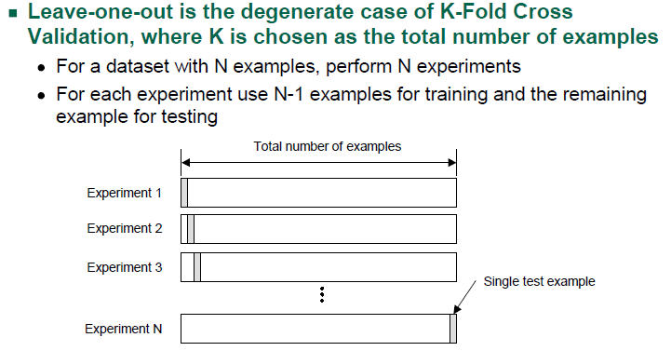
Cross-Validation
(Continued)
<number>/28

Slide 16
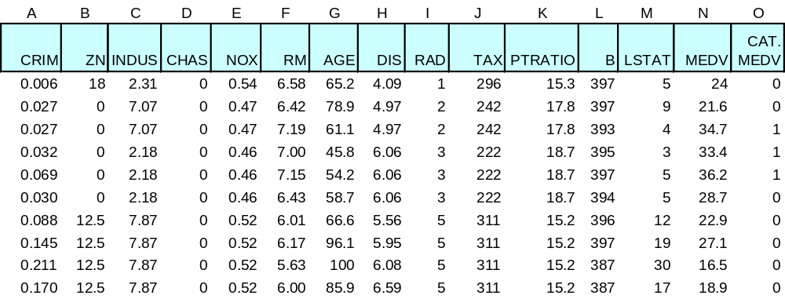
Example: Boston Housing Data
<number>/28

Slide 17
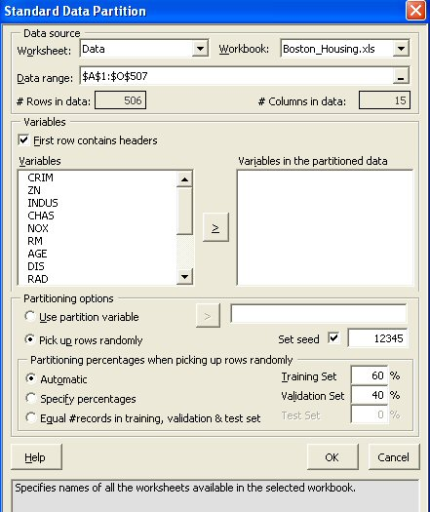
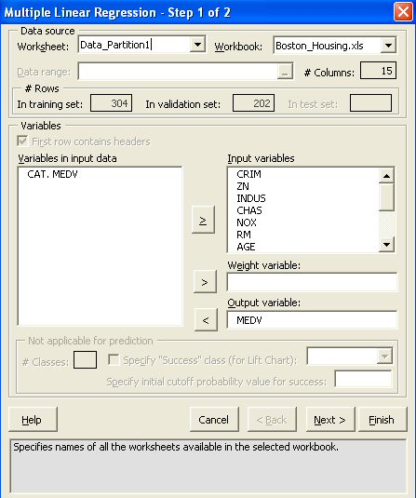
Partitioning & Regression
<number>/28

Slide 18
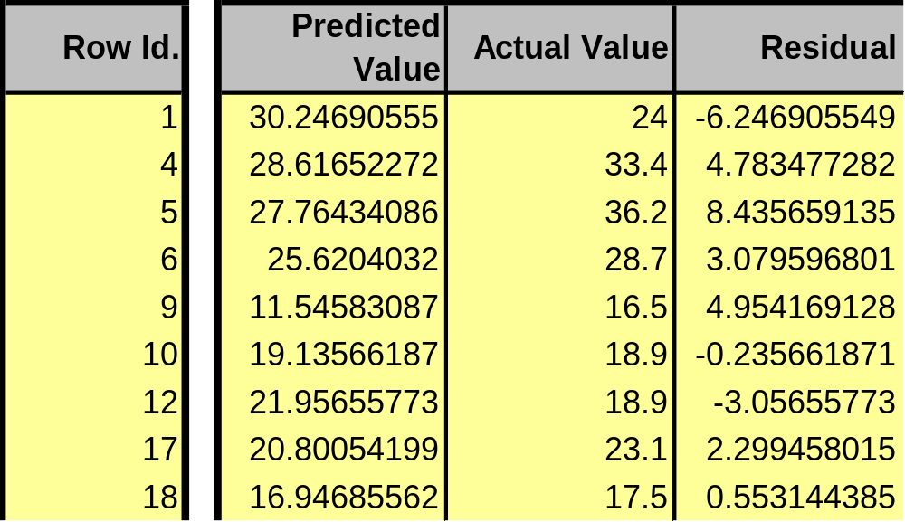
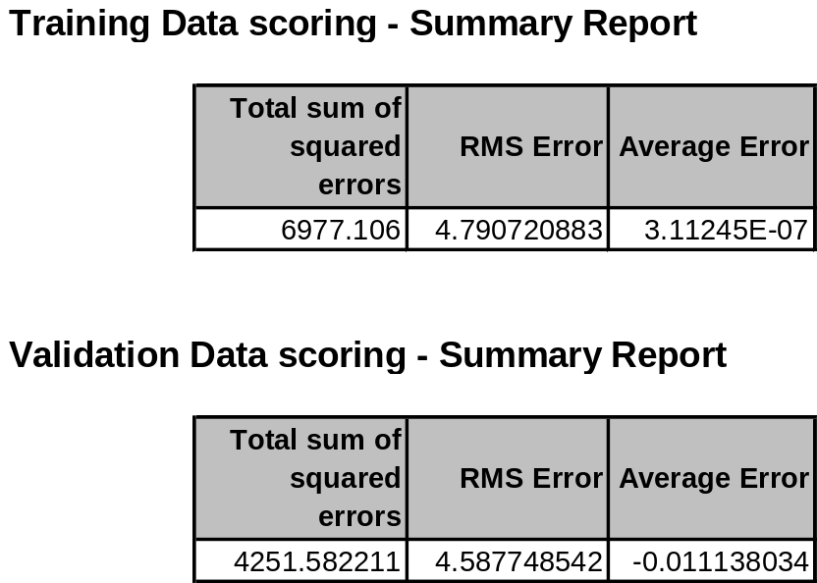
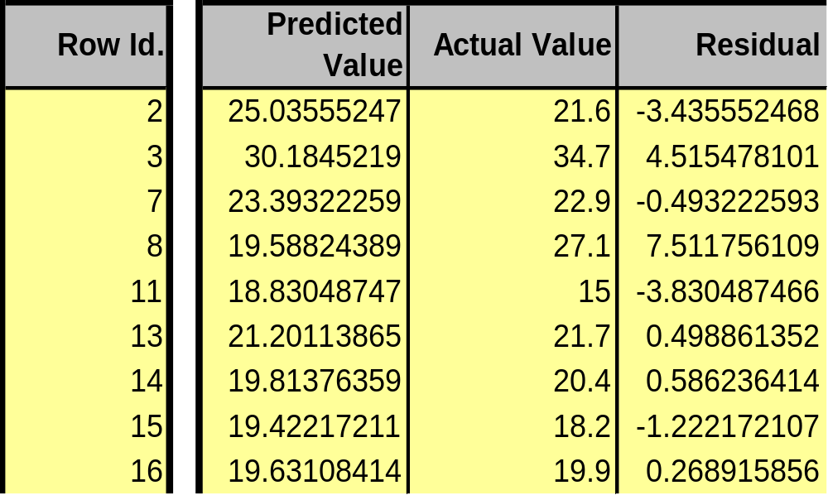
Results
<number>/28

